Slide 2
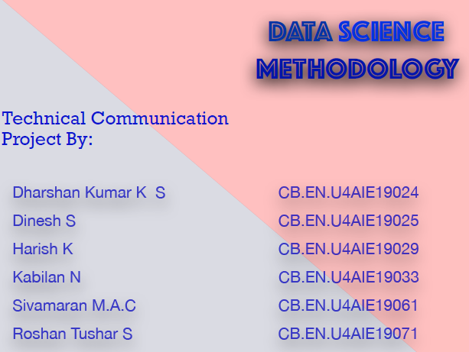

Slide 3
DATA SCIENCE METHODOLOGY
What is a methodology?
A methodology is a defined way of a system of methods used in a particular area of study or activity.
The Data Science Methodology consists of three main steps
i) From problem to approach
ii) Working with the data
Iii) Deriving the answer

Slide 4
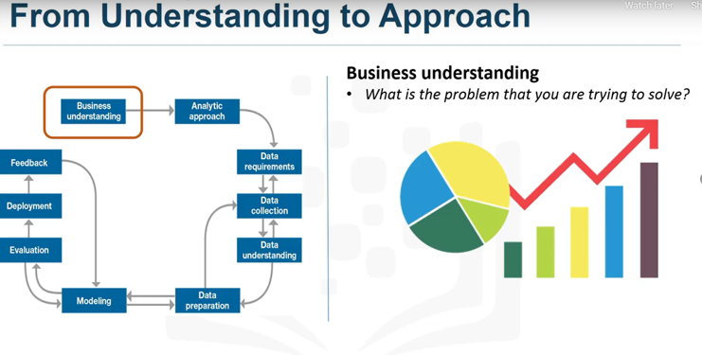
BUSINESS UNDERSTANDING

Slide 5


Slide 6


Slide 7
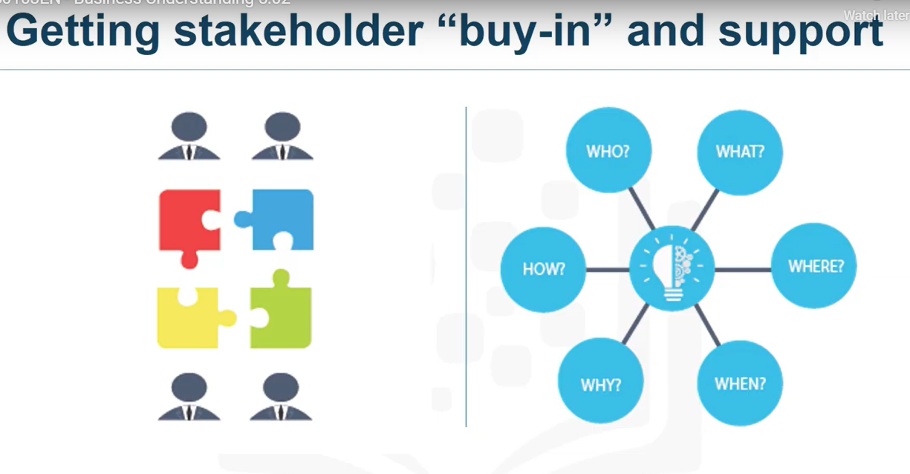

Slide 8
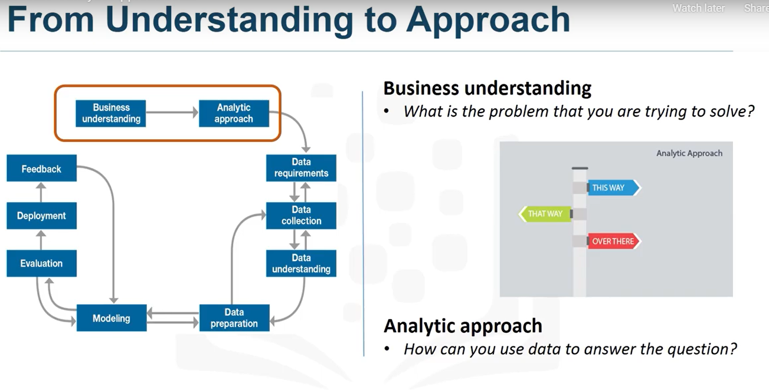
ANALYTIC APPROACH

Slide 9
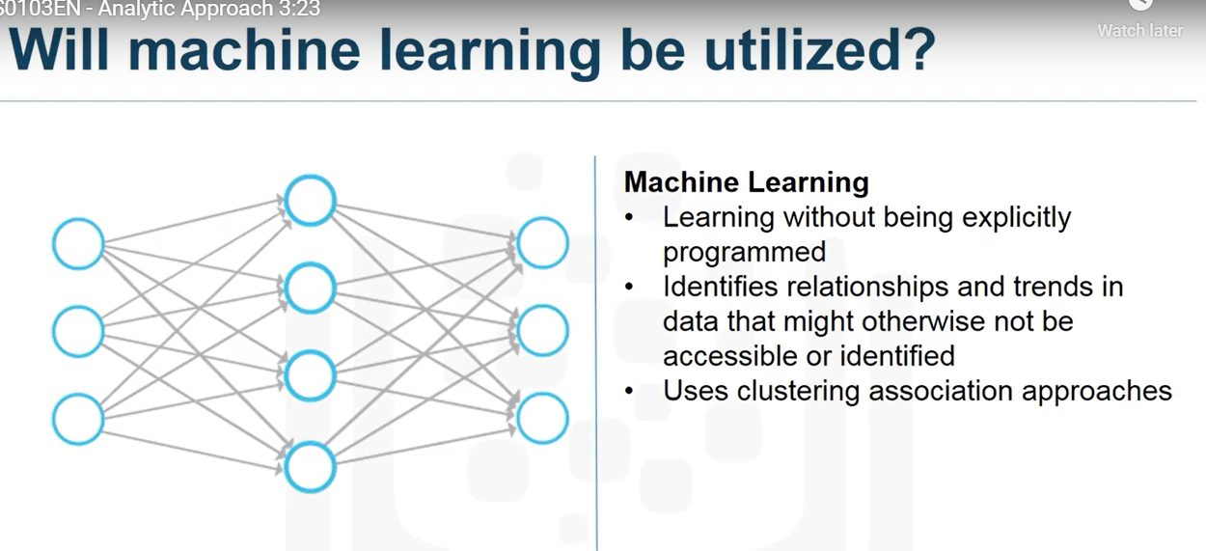

Slide 10
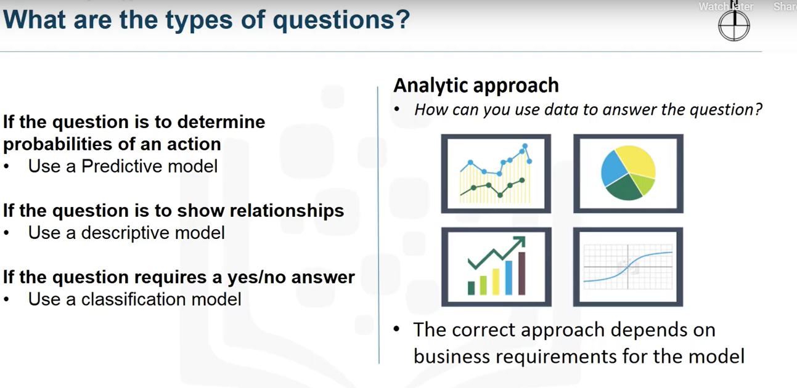

Slide 11
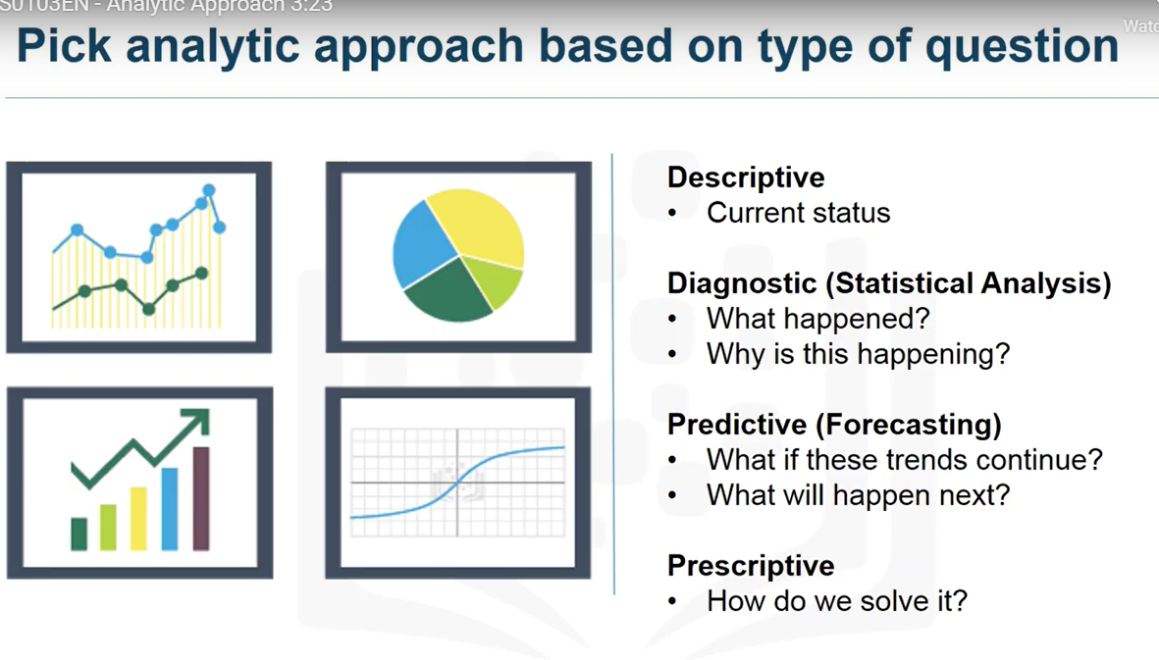

Slide 12

FROM REQUIREMENTS TO COLLECTION
DATA REQUIREMENTS

Slide 13
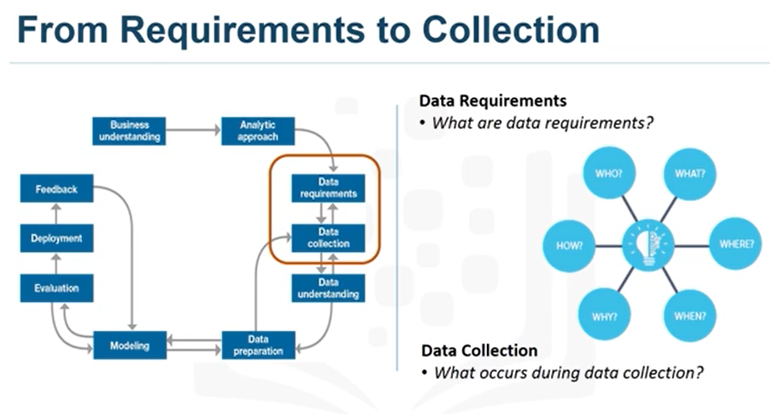

Slide 14
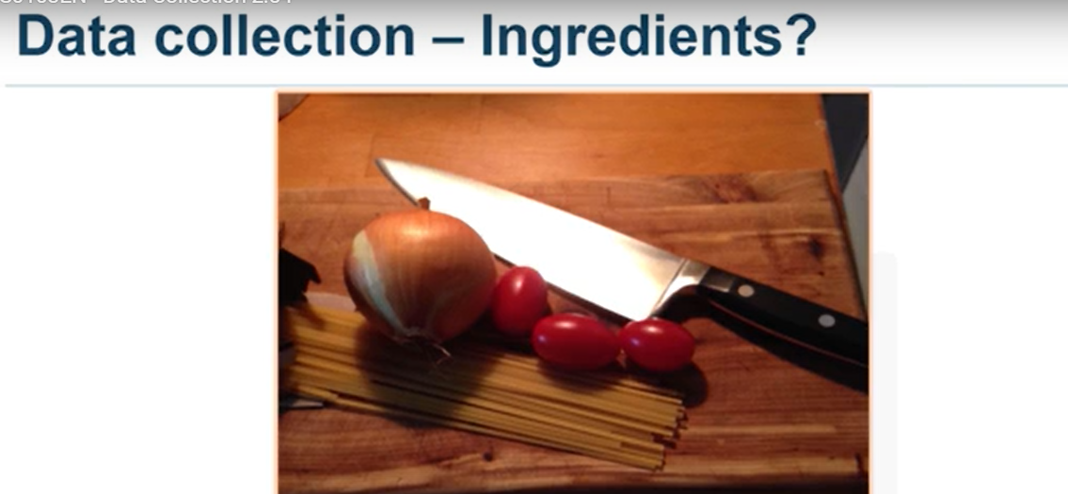
DATA COLLECTION

Slide 15
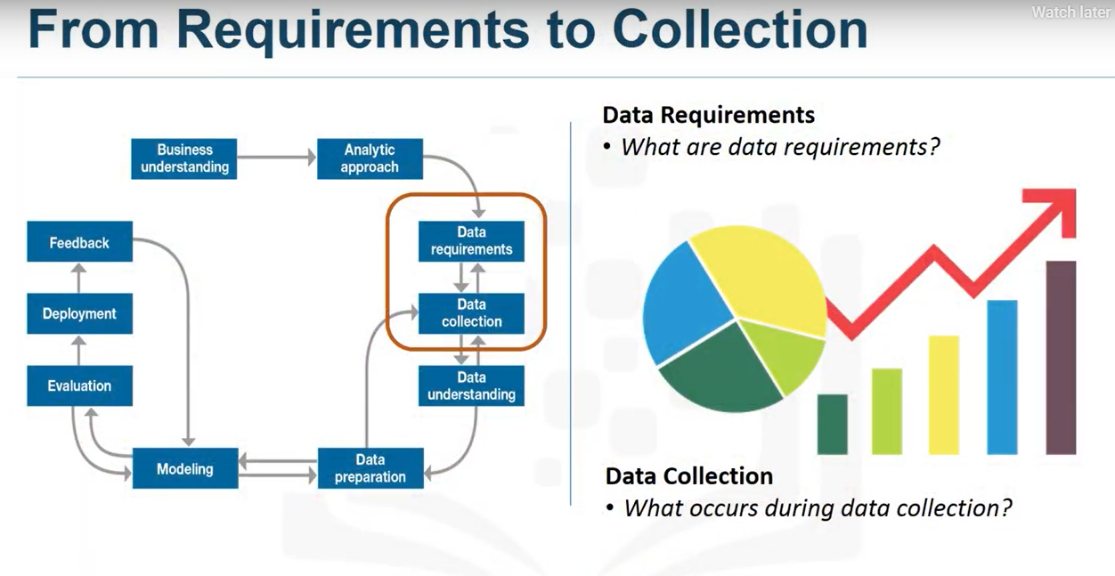

Slide 16
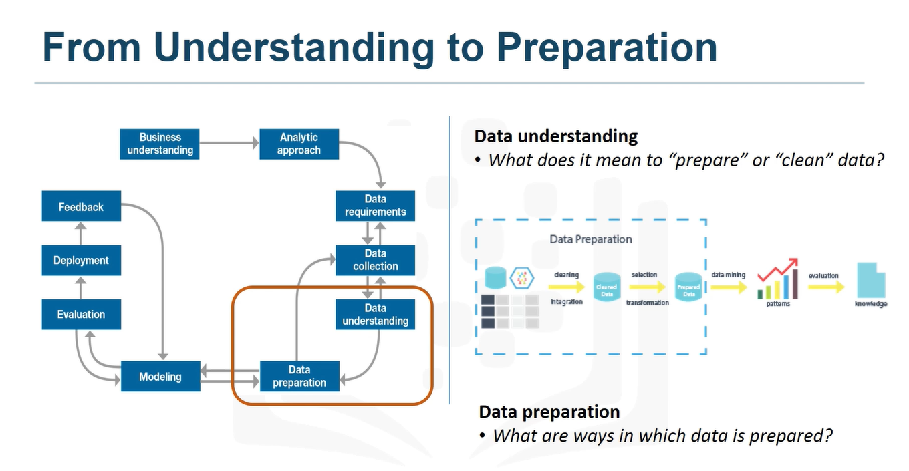
FROM UNDERSTANDING TO PREPARATION
DATA UNDERSTANDING

Slide 17
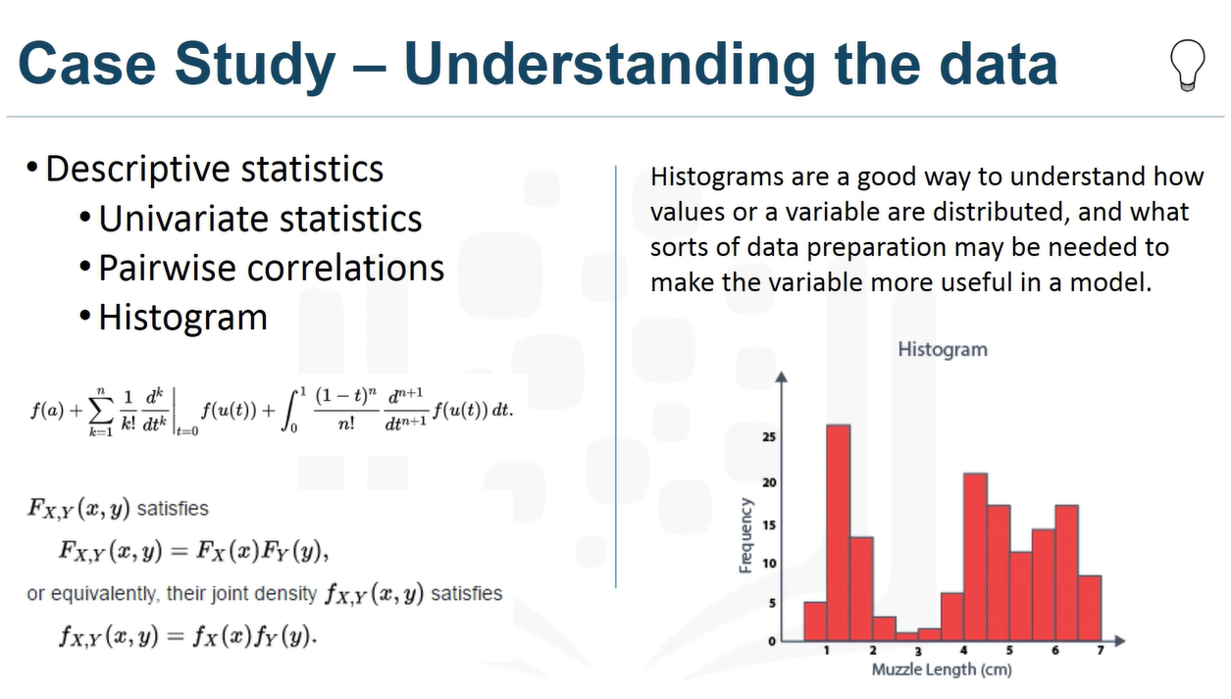

Slide 18

DATA PREPARATION

Slide 19
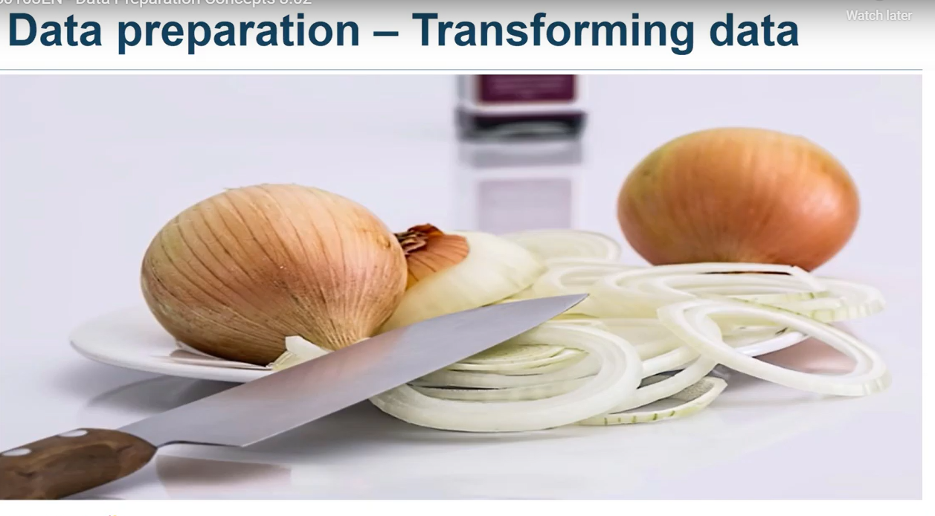

Slide 20
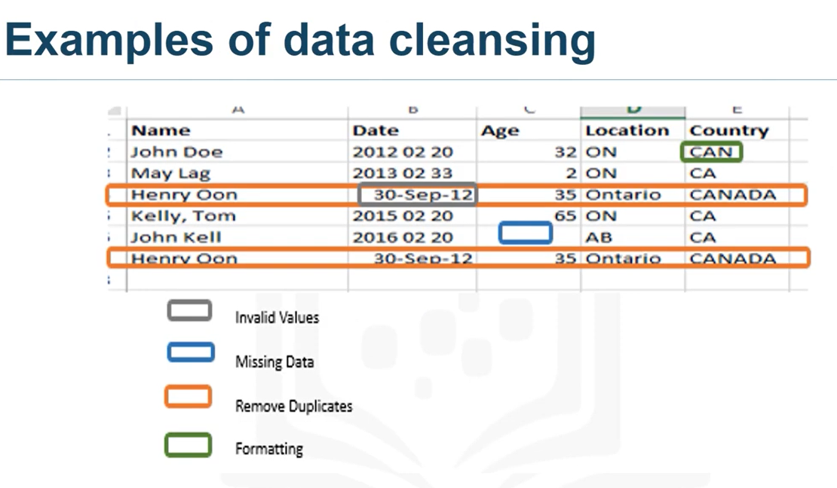

Slide 21
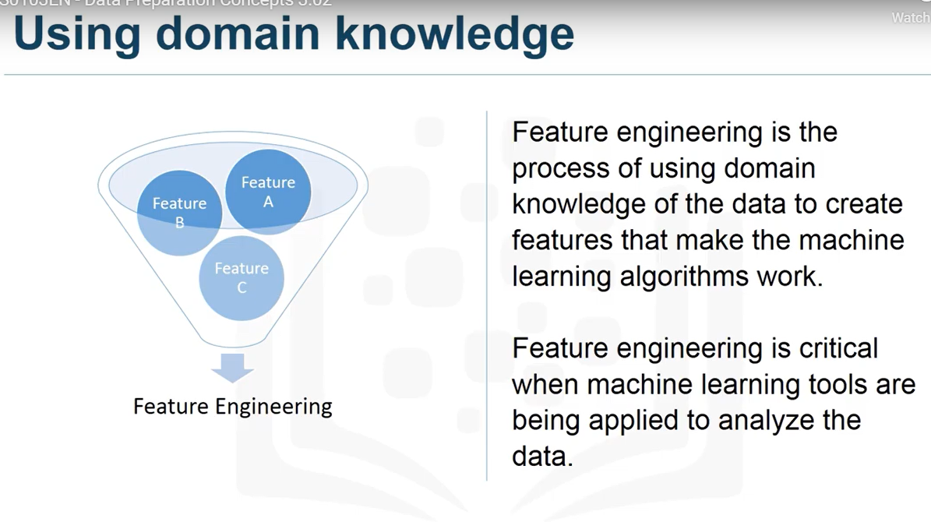

Slide 22
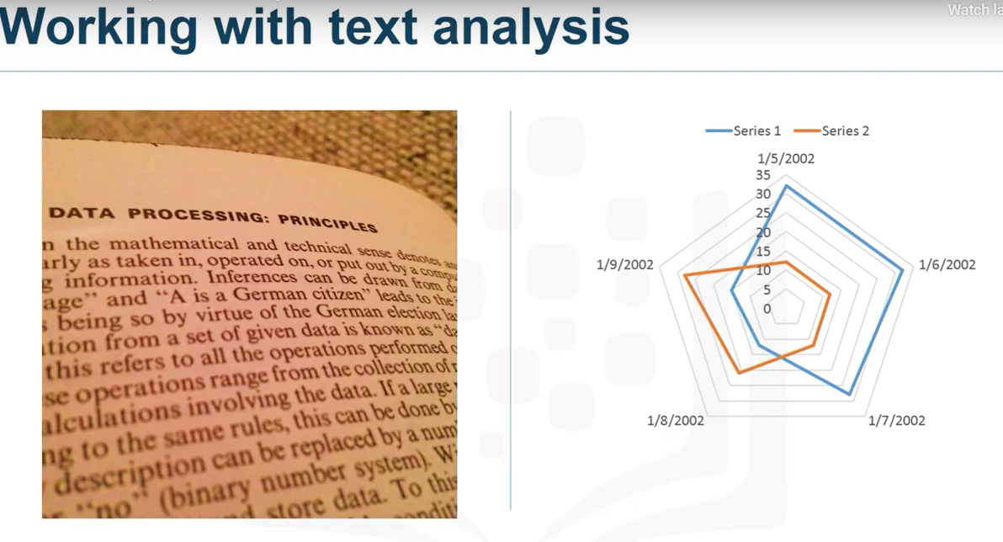

Slide 23
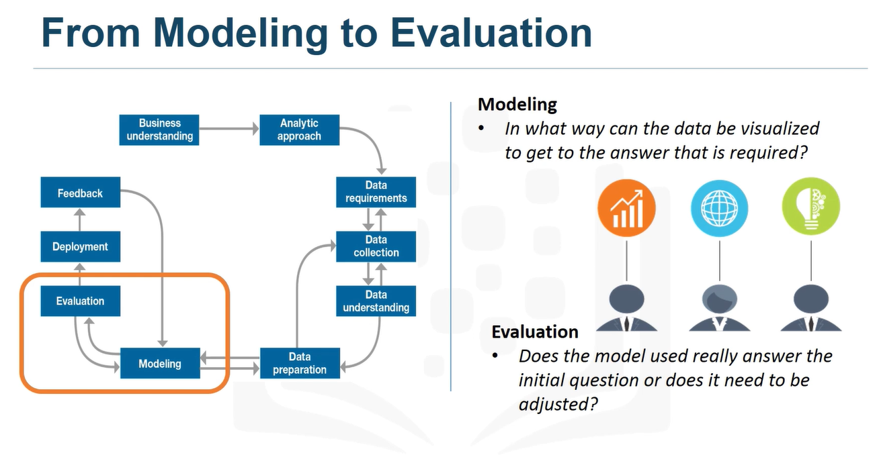
FROM MODELLING TO EVALUATION
MODELLING

Slide 24
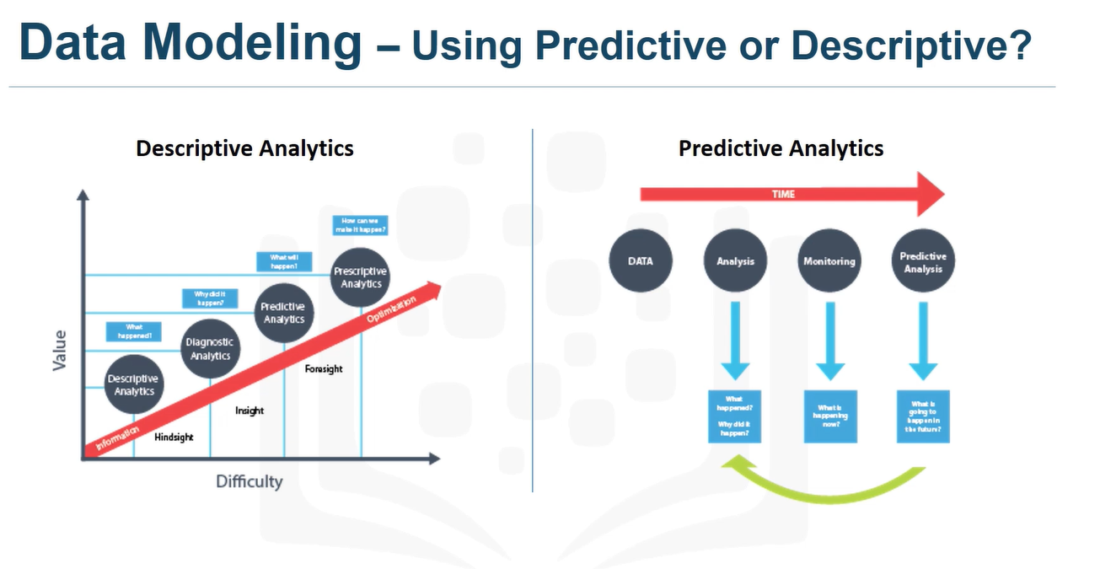

Slide 25
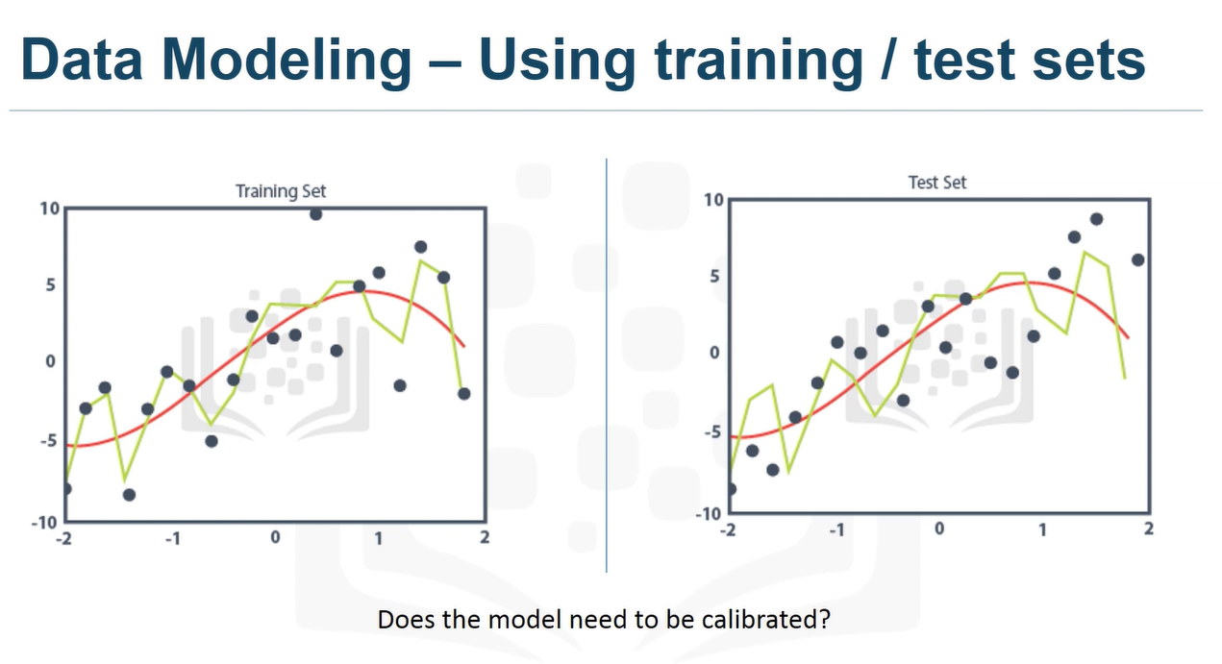

Slide 26
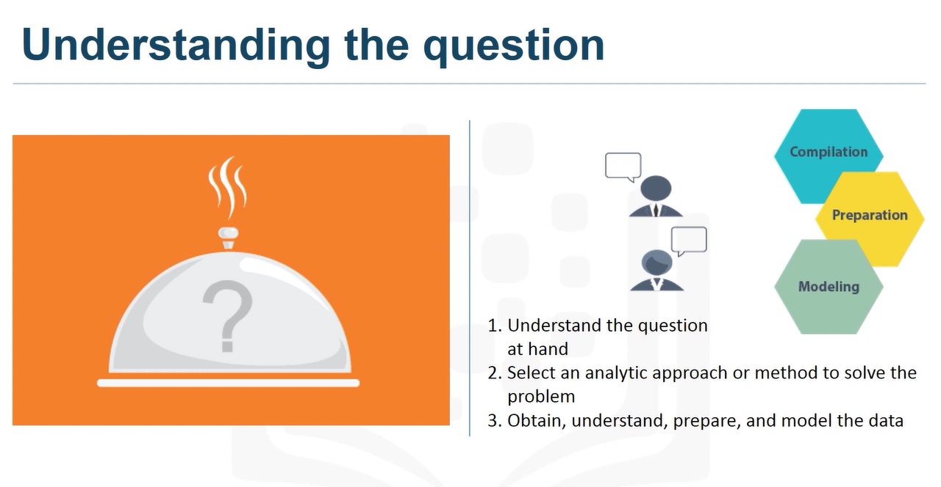

Slide 27


Slide 28
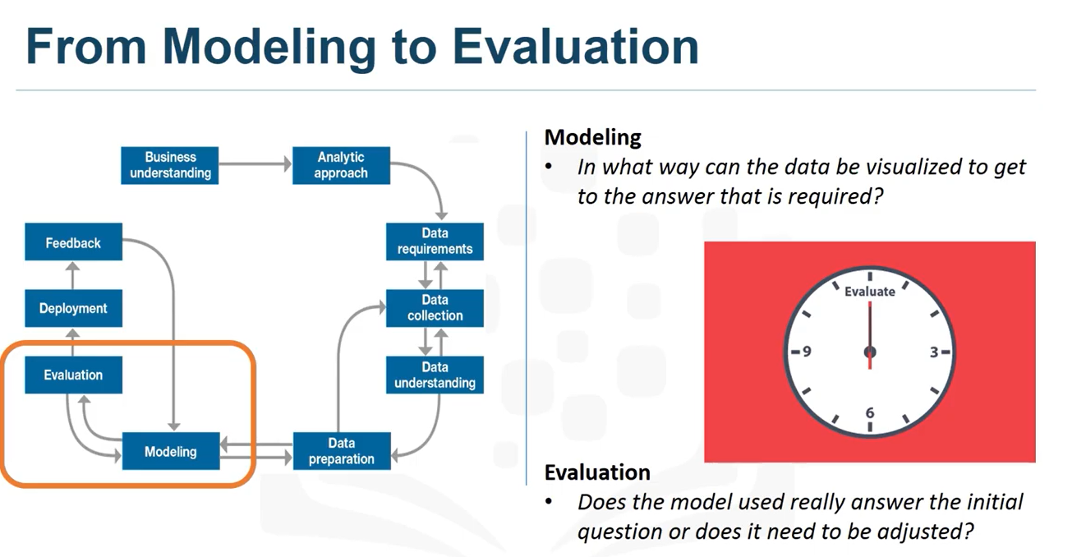
EVALUATION

Slide 29
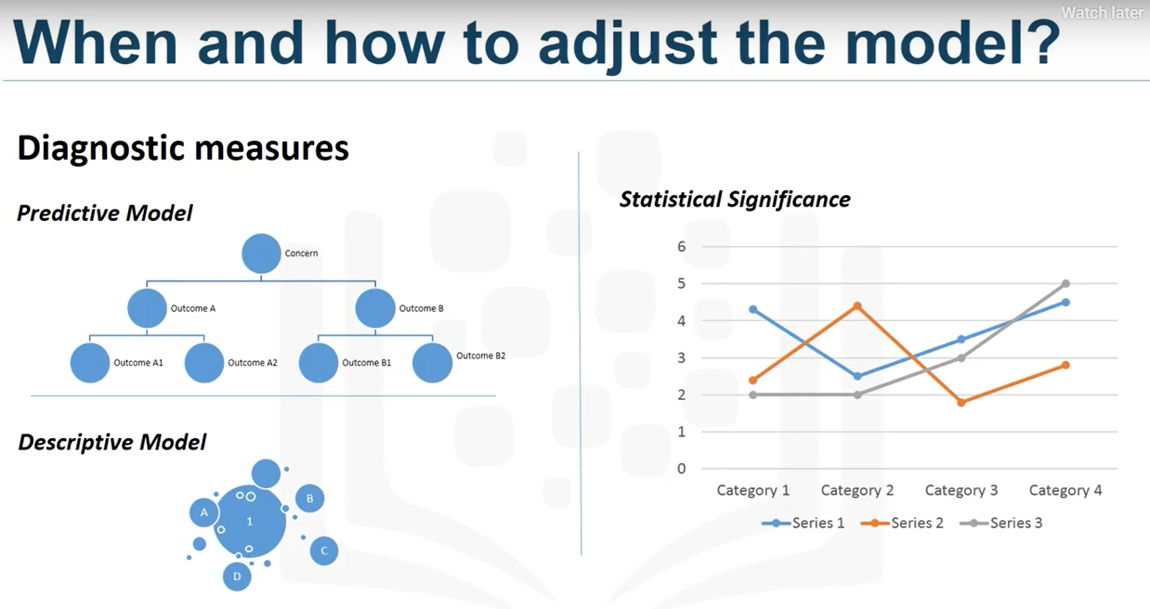

Slide 30

FROM DEPLOYMENT TO FEEDBACK
DEPLOYMENT

Slide 31
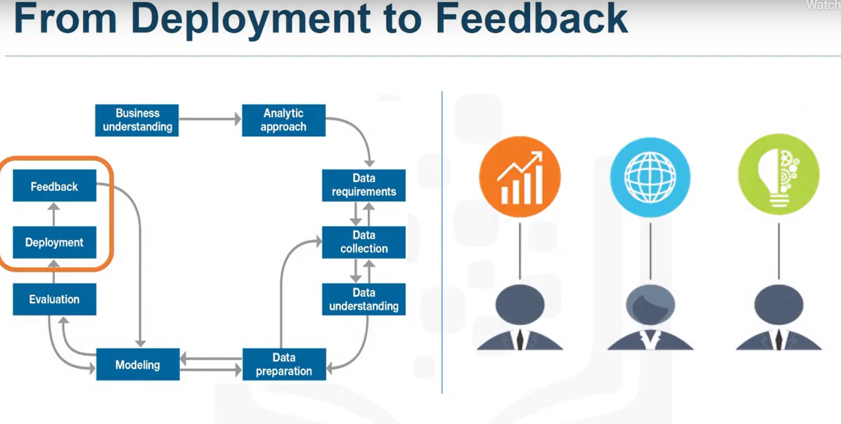

Slide 32
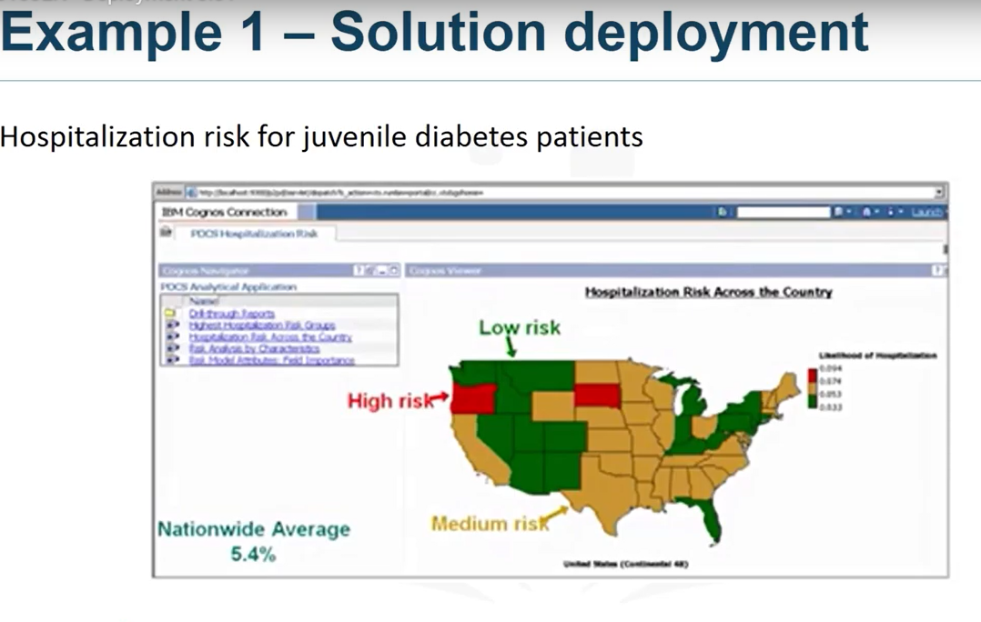

Slide 33
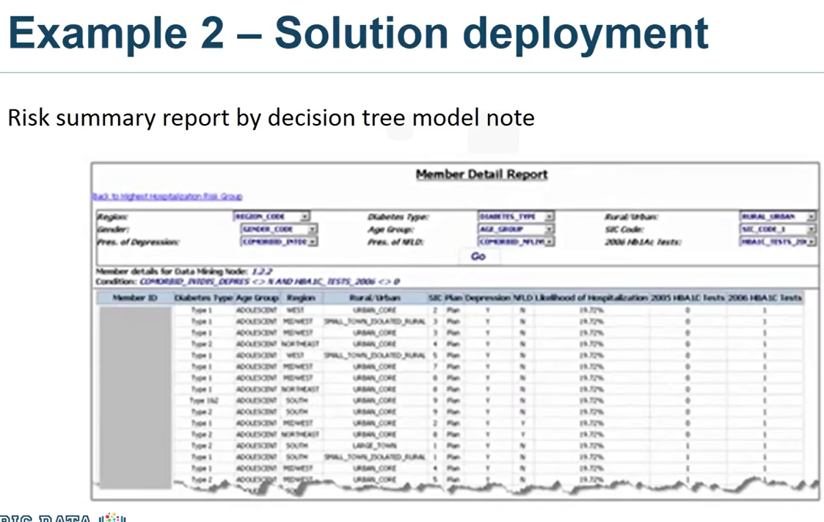

Slide 34

FEEDBACK

Slide 35
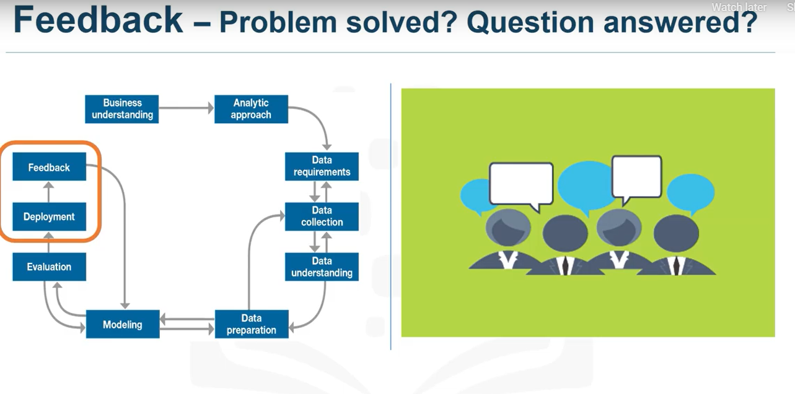

Slide 36
